Slide 1

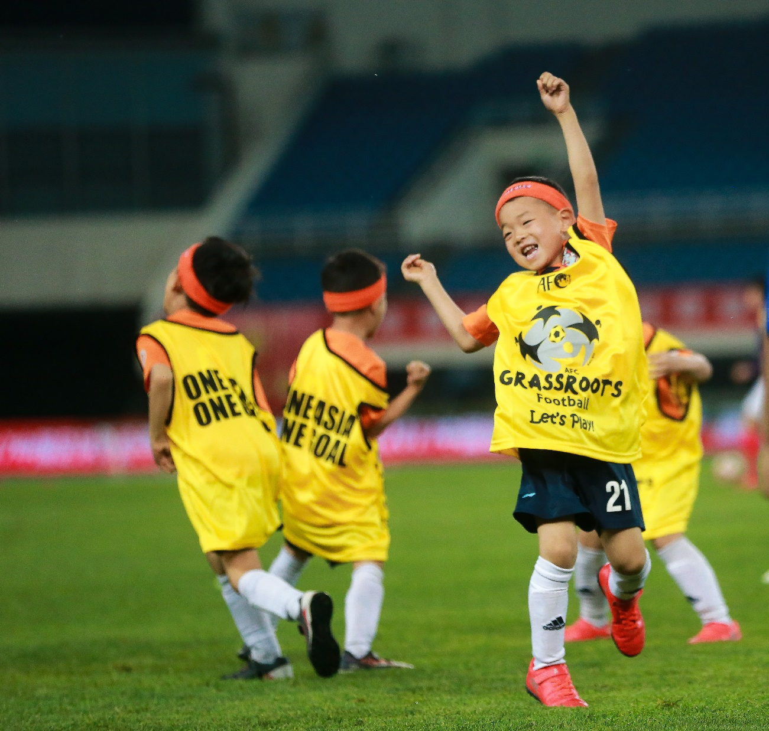

AFC SPECIAL GRASSROOTS AWARDS 2019
Nomination Documents
Introduction

Slide 2
Brief Introduction
Category (评奖类别，下方三选一)：
BEST GRASSROOTS LEADER / BEST GRASSROOTS PROJECT / BEST GRASSROOTS CLUB
Please introduce the reason why you choose to get involved with grassroots football：
Please introduce the overall objectives of your work：

Slide 3
Nominee Introduction
For “BEST GRASSROOTS LEADER” nominee only
Any achievements have been reached？
2. Any long-term plan has been setted? Please introduce.
3. Impacts/Outcomes for current work

Slide 4
Nominee Introduction
For “BEST GRASSROOTS PROJECT” nominee only
1. What is the philosophy of your project？
2. Any innovation work of your project? Please introduce.
3. Please introduce some social responsibility work which your project has done.
4. Impacts/Outcomes for current work
5. Who are the participants of the project? (age, gender, level of playing ability, disabled, etc.)

Slide 5
Nominee Introduction
For “BEST GRASSROOTS CLUB” nominee only
1. What is the holistic grassroots approach for your club?
2. How is the operation status of the club?
3. Who are the participants of the project? (age, gender, level of playing ability, disabled, etc.)
4. How is the partnership of the club? (with schools or other local insitutions)
5. Please introduce the contents of club normal activities.

Slide 6
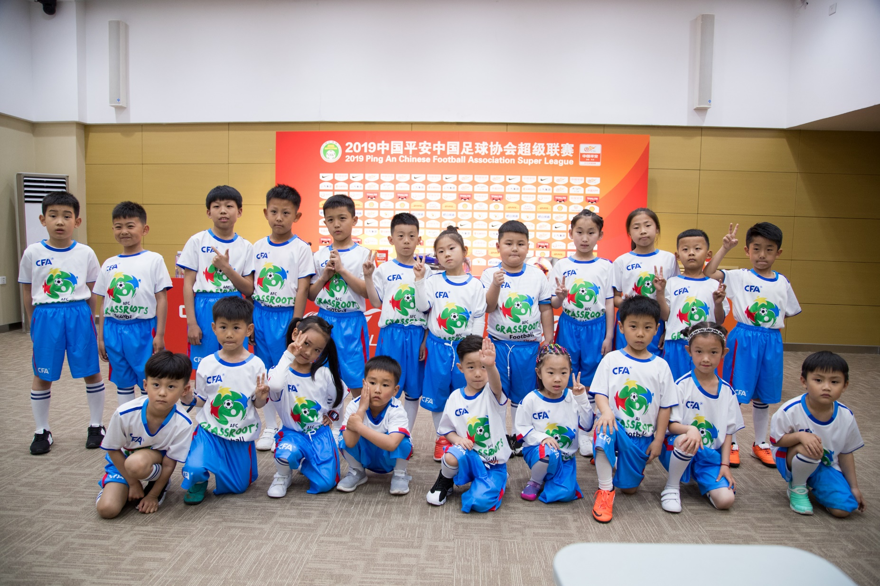
Thank You

